Slide 1
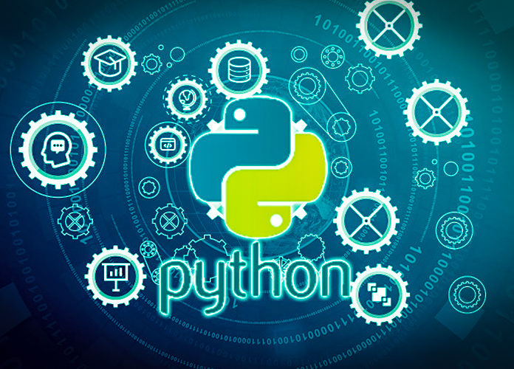
Data Programming in Python _________________ Module 1 Wrap-up

Slide 2


BAIS 6040: Data Programming in Python
Module Objectives:
Outline course objectives and expectations
Cover utility of Python
Interface of Jupyter Notebook
Debugging and AI

Slide 3
BAIS 6040: Data Programming in Python
We learned:
Introduction to Python
Introduction to Jupyter Notebook
Data Types: Numbers and Strings
Artificial Intelligence
Debugging

